Slide 1

Preparation for Lab 1
Week 2
Semester 1, 2025
Dr. Farshid Keivanian

Slide 2
Preparation for Lab 1: Cyber Career Exploration Workshop
This workshop is an interactive online experience designed to help students explore cybersecurity careers. It is facilitated by the Australian Signals Directorate (ASD) CyberEXP initiative. The goal is to let students experience a day in the life of five ASD cyber professionals, understanding their tasks and responsibilities in real-world cybersecurity.

Slide 3
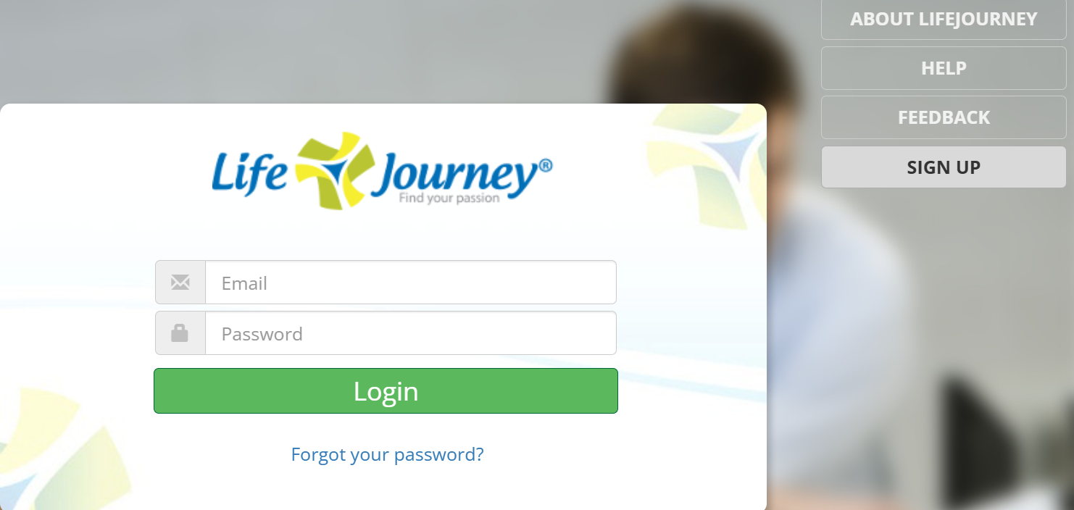
Preparation for Lab 1: Cyber Career Exploration Workshop
Workshop Instructions
Step 1: Open the website: https://au.golifejourney.com
Step 2: Register for the system
Role: Student
Email: Use your ACU email
Code: refer to Canvas

Slide 4
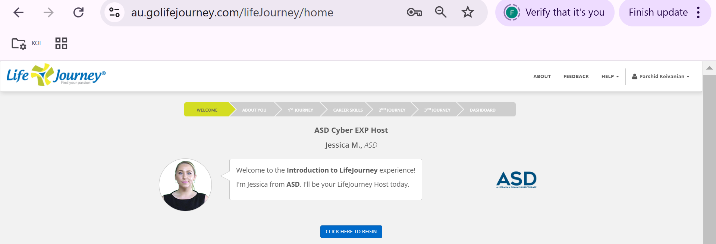
Preparation for Lab 1: Cyber Career Exploration Workshop
After Registration is completed, you will see this page
Step 3: Click on “Click here to begin” to start the workshop.
Through this hands-on activity, students will gain insight into cybersecurity careers and develop problem-solving skills used by professionals in the field.

Slide 5
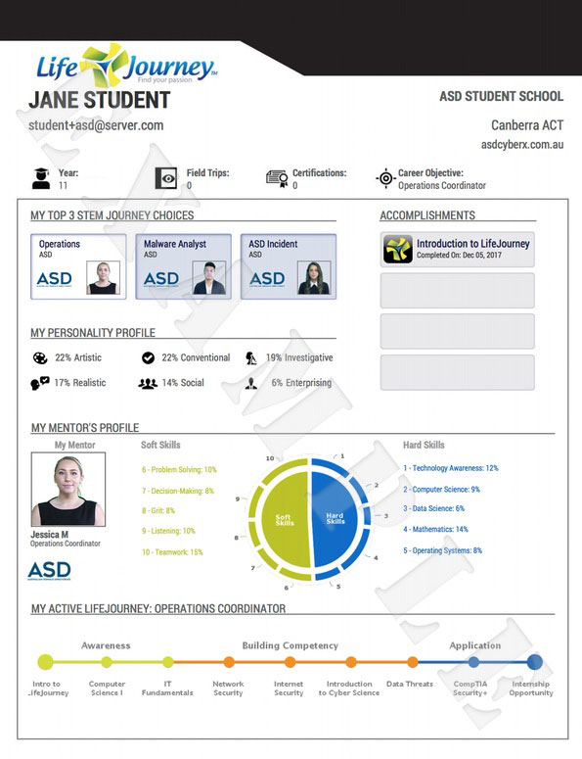
Preparation for Lab 1: Cyber Career Exploration Workshop
This Life Journey profile shows a student's cybersecurity career exploration path through the ASD CyberEXP initiative. It includes career choices, personality traits, mentor details, skill development, and a structured learning journey from basic IT fundamentals to advanced cybersecurity concepts, leading to an internship opportunity.

Slide 6
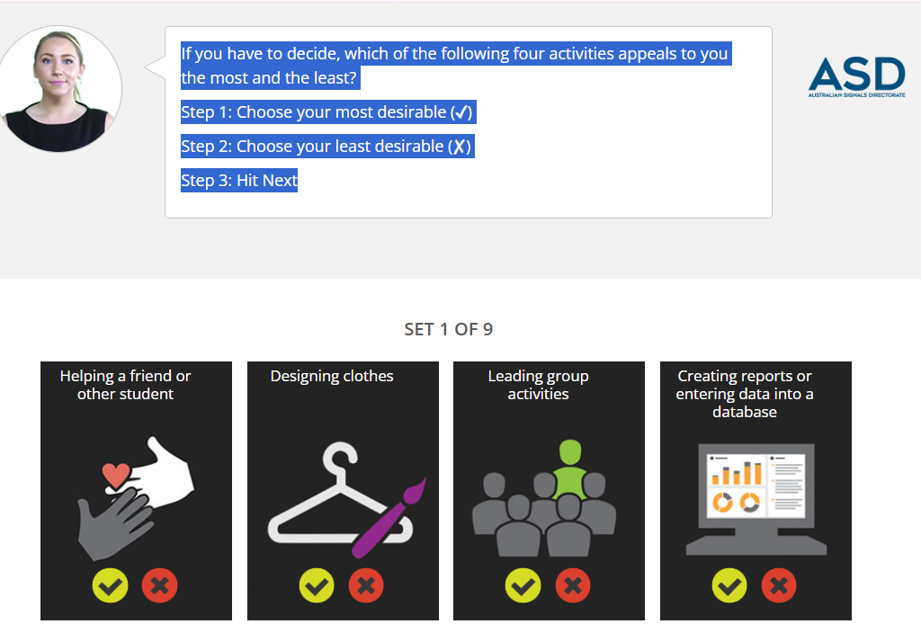
Preparation for Lab 1: Cyber Career Exploration Workshop
Step 4: Watch the videos and complete each section of the lifejourney.

Slide 7
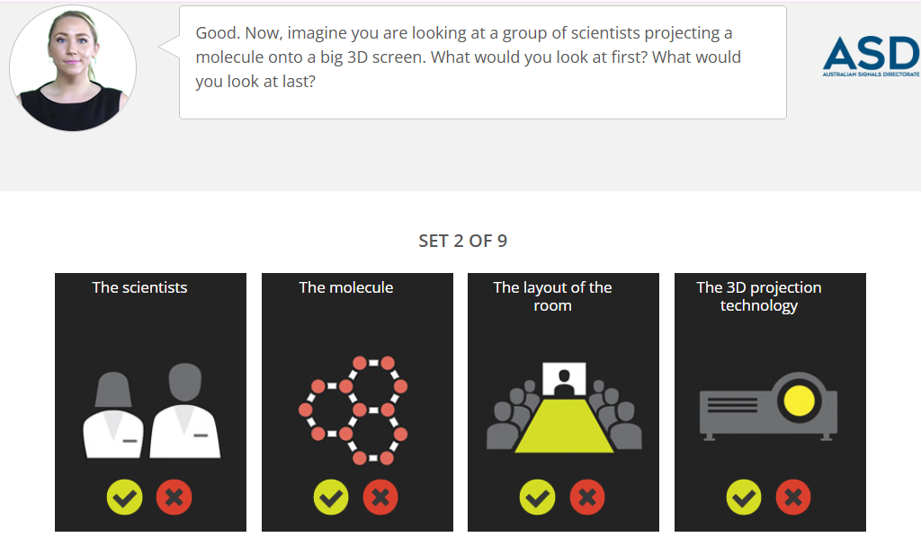
Preparation for Lab 1: Cyber Career Exploration Workshop
Options:
The scientists presenting.
The molecule being projected.
The layout of the room.
The 3D projection technology.
This activity helps identify analytical thinking styles—whether you focus more on people, details, environment, or technology.

Slide 8
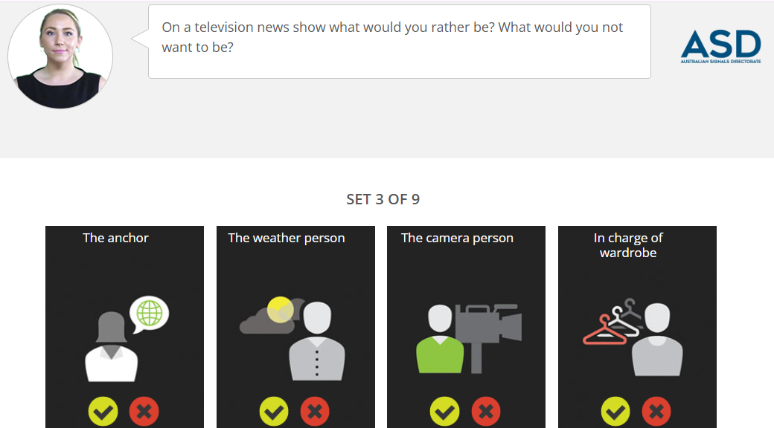
Preparation for Lab 1: Cyber Career Exploration Workshop
In any industry, including cybersecurity and technology, different roles suit different personalities and skills. This activity helps students identify their strengths and preferences in a team setting.

Slide 9
Preparation for Lab 1: Cyber Career Exploration Workshop
Activity Instructions:
Imagine working on a television news show.
Question: Which role would you prefer? Which role would you avoid?
Options:
The anchor – The face of the news, presenting information to the audience.
The weather person – Reporting on weather updates and forecasts.
The camera person – Operating the camera and handling technical aspects.
In charge of wardrobe – Managing clothing and appearance for the show.

Slide 10
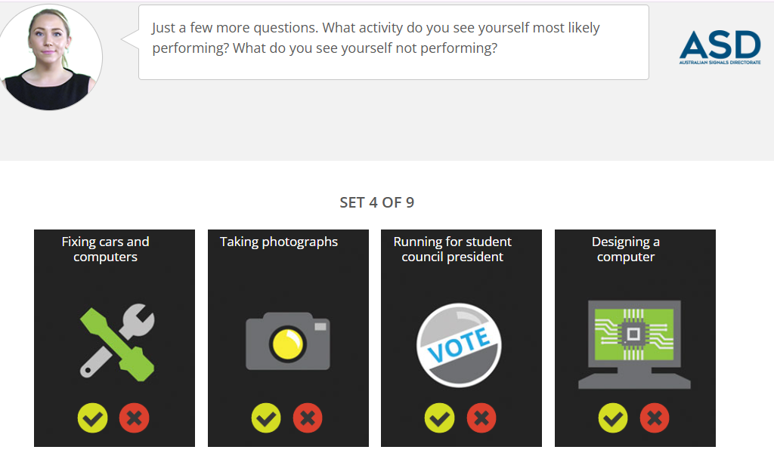
Preparation for Lab 1: Cyber Career Exploration Workshop
Choosing the right career starts with understanding your skills and interests. This activity helps students reflect on what tasks they enjoy and what they might avoid, guiding them toward suitable career paths.

Slide 11
Preparation for Lab 1: Cyber Career Exploration Workshop
Options:
Fixing cars and computers – Problem-solving and hands-on technical work.
Taking photographs – Creative and visual storytelling.
Running for student council president – Leadership and public engagement.
Designing a computer – Technical and engineering-focused work.
This activity helps students recognize if they prefer hands-on work, creative fields, leadership roles, or technical design, allowing them to explore careers that match their strengths.

Slide 12
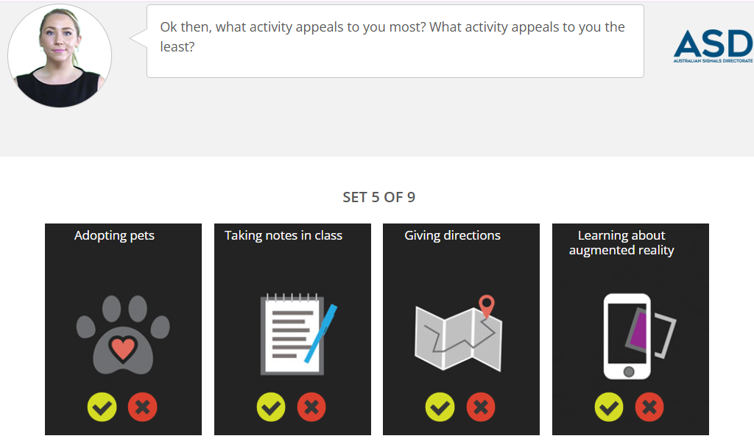
Preparation for Lab 1: Cyber Career Exploration Workshop
Every individual has different interests, which can help guide their career and personal growth. This activity helps students identify what they enjoy doing and what they may not prefer, giving insights into their learning and work style.

Slide 13
Preparation for Lab 1: Cyber Career Exploration Workshop
Options:
1. Adopting pets – Caring for animals and being compassionate.
2. Taking notes in class – Organizing information and active learning.
3. Giving directions – Communication and guiding others.
4. Learning about augmented reality – Exploring new technology and innovation.

Slide 14
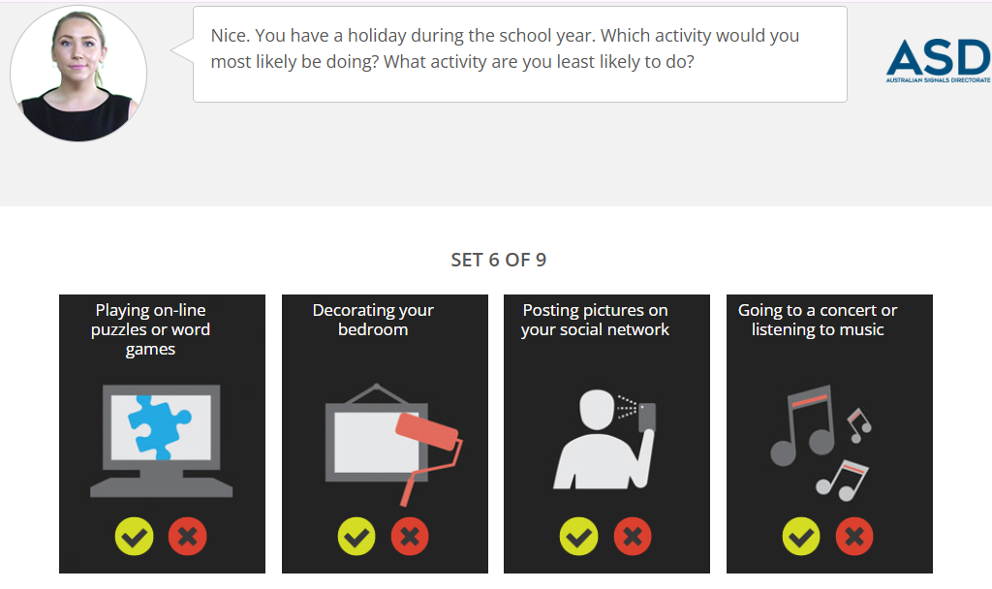
Preparation for Lab 1: Cyber Career Exploration Workshop
People spend their free time in different ways based on their interests. This activity helps students understand what they enjoy doing the most and what they might avoid, which can reflect their personality and career inclinations.

Slide 15
Preparation for Lab 1: Cyber Career Exploration Workshop
Options:
1. Playing online puzzles or word games – Problem-solving and critical thinking.
2. Decorating your bedroom – Creativity and personal expression.
3. Posting pictures on your social network – Social engagement and digital interaction.
4. Going to a concert or listening to music – Enjoying entertainment and relaxation.

Slide 16
Preparation for Lab 1: Cyber Career Exploration Workshop
This exercise helps students recognize if they are more analytical, creative, social, or entertainment-focused, which can help guide their learning and career preferences.

Slide 17
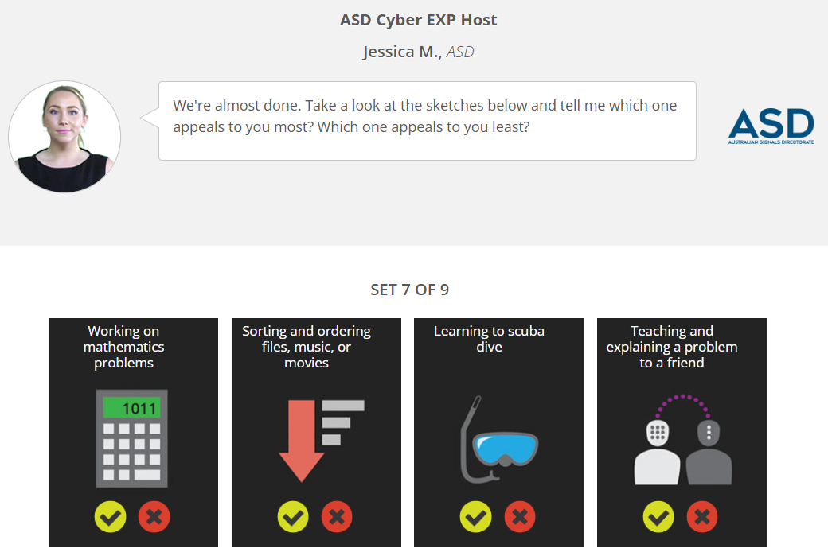
Preparation for Lab 1: Cyber Career Exploration Workshop
People learn and work differently, and understanding personal preferences can help in choosing the right career path. This activity helps students reflect on what they enjoy doing and what they may avoid.

Slide 18
Preparation for Lab 1: Cyber Career Exploration Workshop
Options:
1. Working on mathematics problems – Logical and analytical thinking.
2. Sorting and ordering files, music, or movies – Organization and attention to detail.
3. Learning to scuba dive – Adventure and hands-on experiences.
4. Teaching and explaining a problem to a friend – Communication and leadership skills.

Slide 19
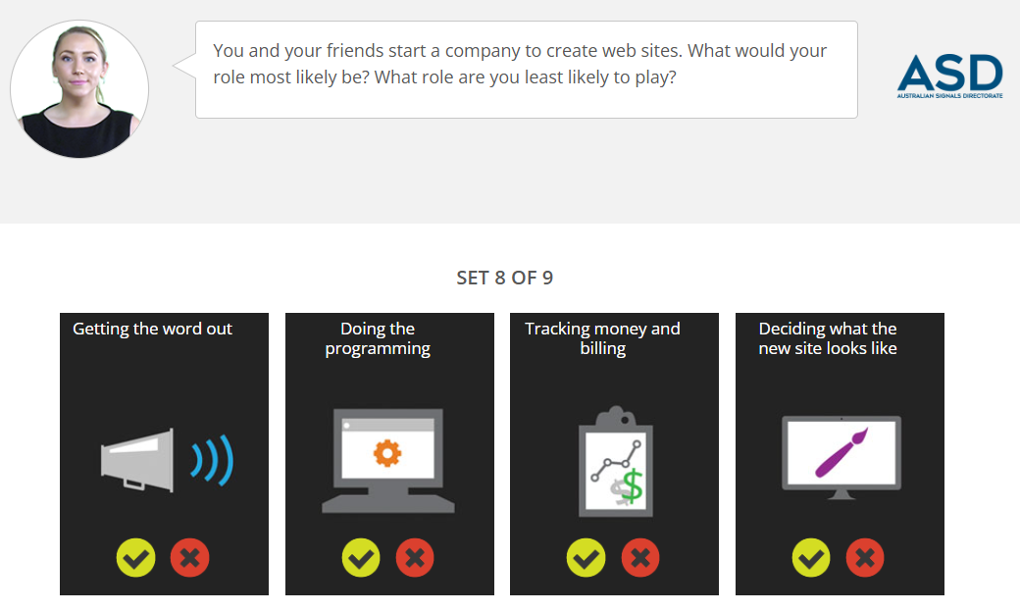
Preparation for Lab 1: Cyber Career Exploration Workshop
In any technology project, different people take on different roles based on their skills and interests. This activity helps students recognize which role they would prefer and which one they would avoid in a web development team.

Slide 20
Preparation for Lab 1: Cyber Career Exploration Workshop
Options:
1. Getting the word out – Marketing and promoting the website.
2. Doing the programming – Writing code and building the website.
3. Tracking money and billing – Managing finances and payments.
4. Deciding what the new site looks like – Designing the user interface.

Slide 21
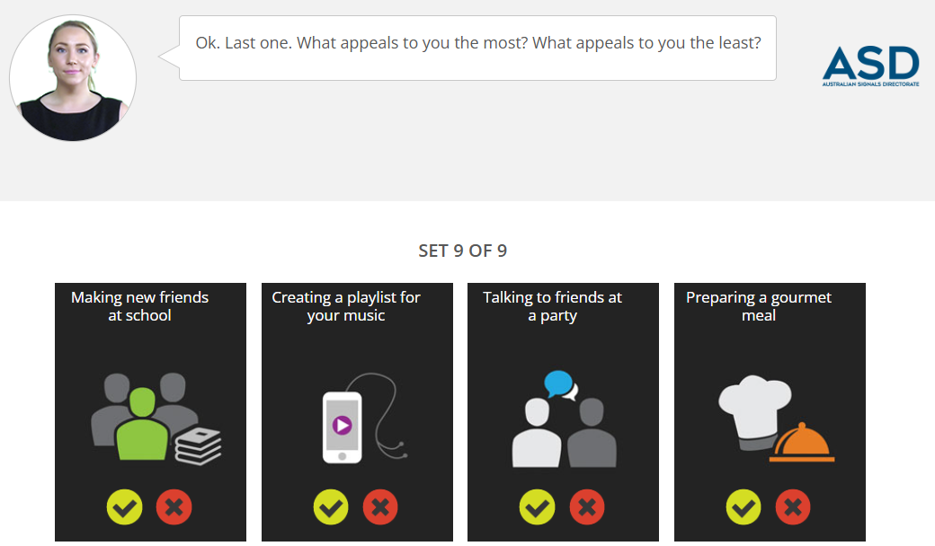
Preparation for Lab 1: Cyber Career Exploration Workshop
Options:
1. Making new friends at school – Socializing and building relationships.
2. Creating a playlist for your music – Organizing and curating music.
3. Talking to friends at a party – Engaging in conversations in social settings.
4. Preparing a gourmet meal – Cooking and creativity in the kitchen.

Slide 22
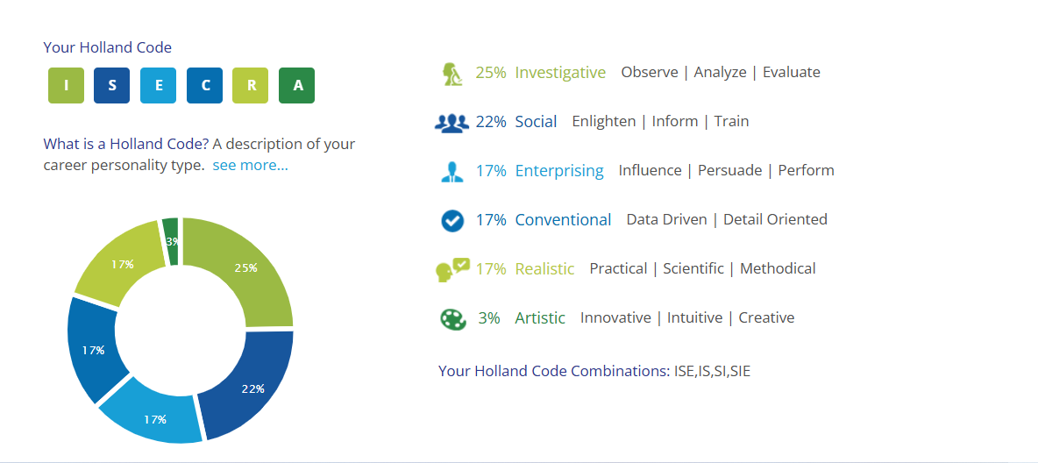
Preparation for Lab 1: Cyber Career Exploration Workshop

Slide 23
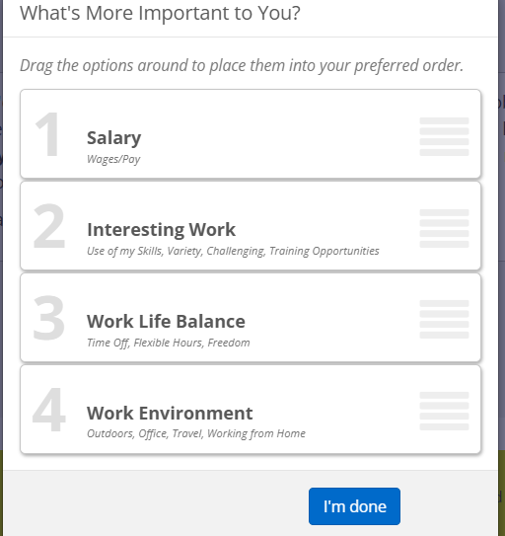
Preparation for Lab 1: Cyber Career Exploration Workshop
Options:
1. Salary – Wages and financial security.
2. Work Environment – Office setup, remote work, or travel.
3. Work-Life Balance – Time off, flexibility, and personal freedom.
4. Interesting Work – Learning opportunities, challenges, and skill development.

Slide 24
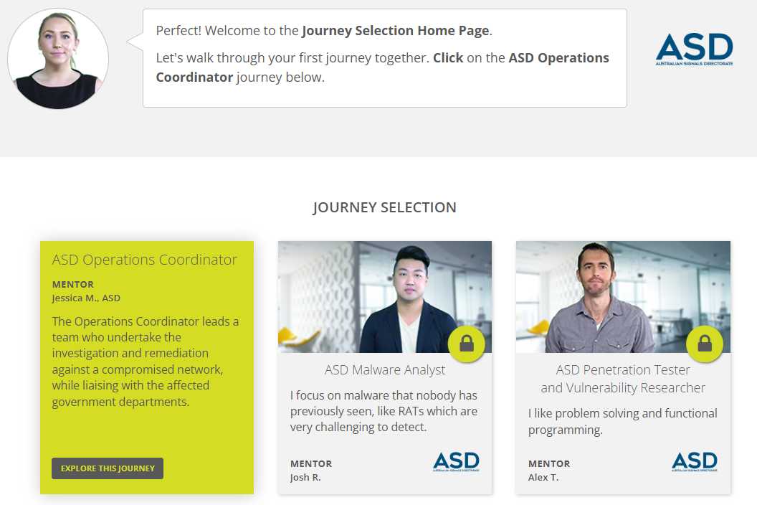
Preparation for Lab 1: Cyber Career Exploration Workshop
Click on “Explore This Journey”

Slide 25
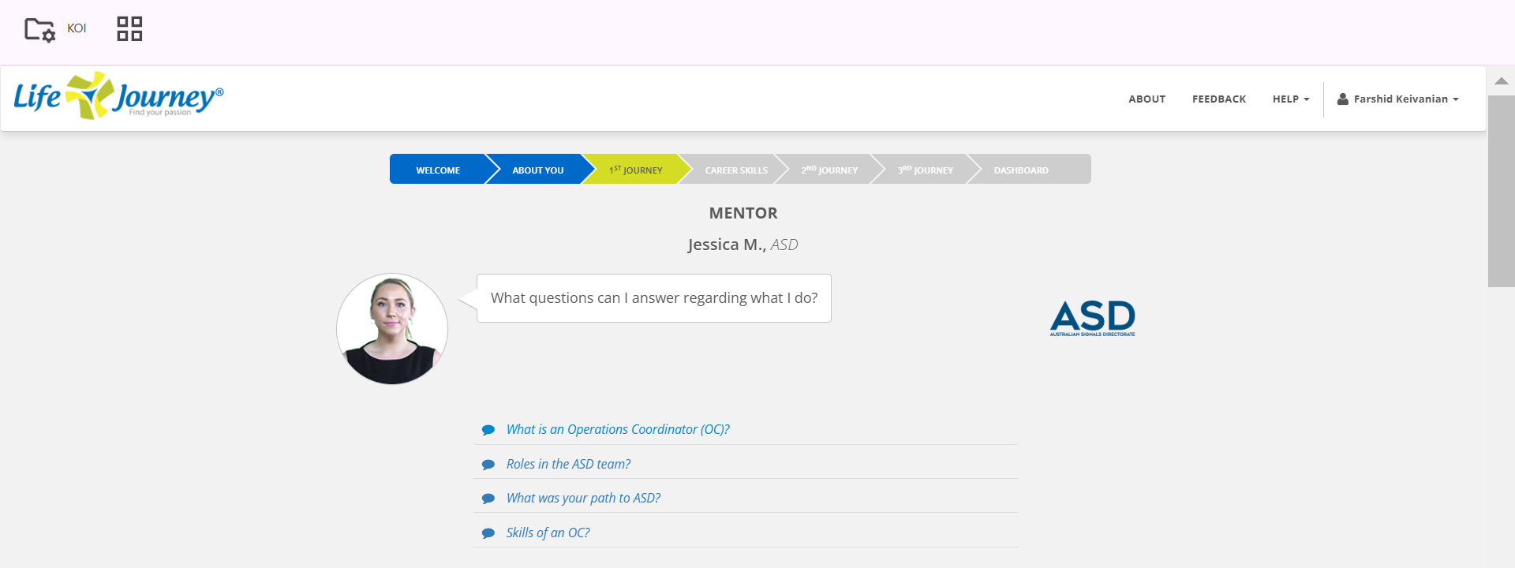
Preparation for Lab 1: Cyber Career Exploration Workshop

Slide 26
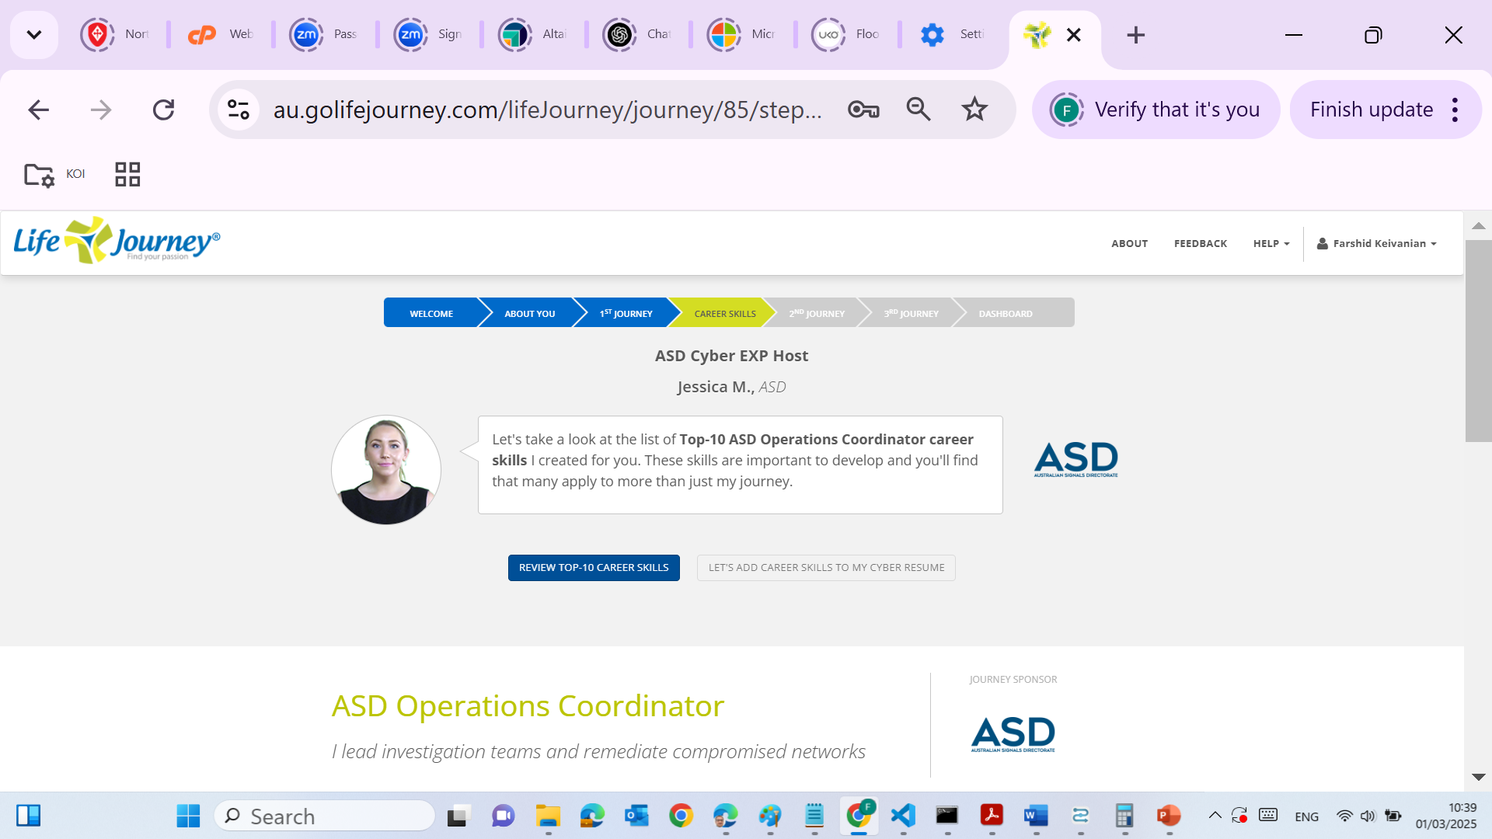
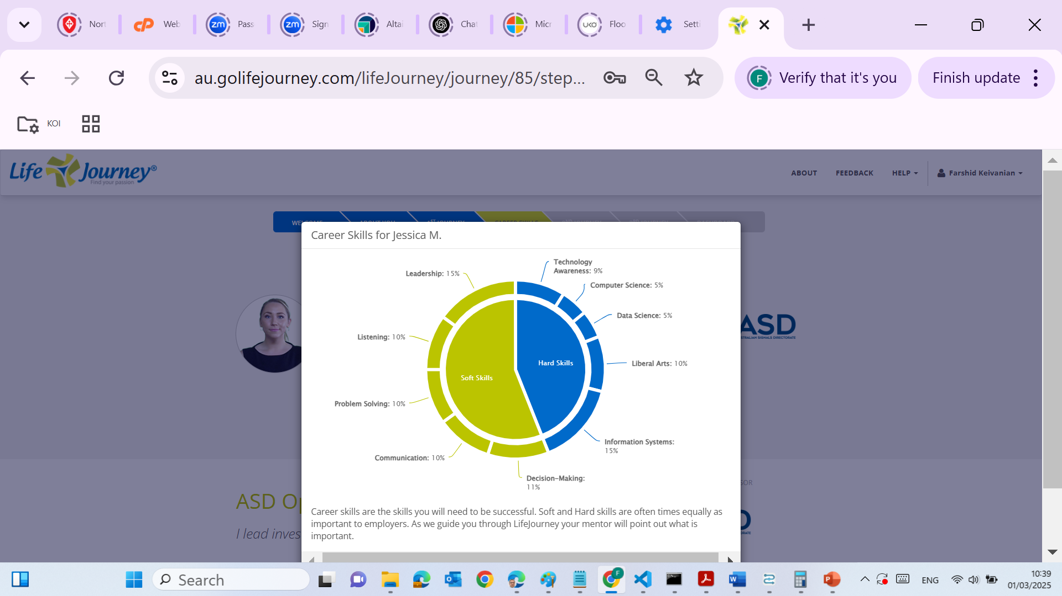
Preparation for Lab 1: Cyber Career Exploration Workshop

Slide 27
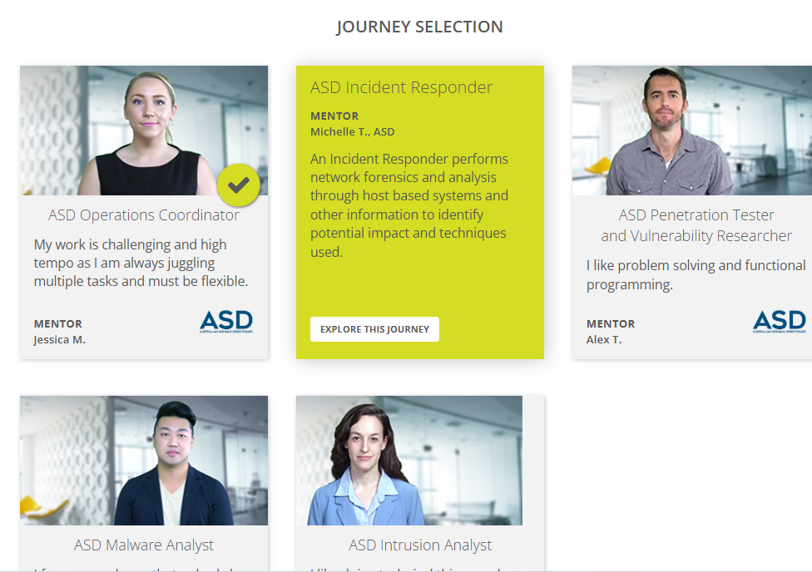
Preparation for Lab 1: Cyber Career Exploration Workshop

Slide 28
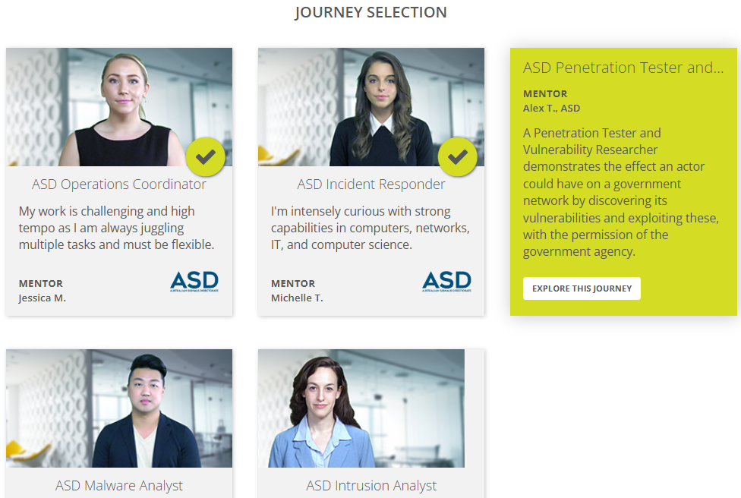
Preparation for Lab 1: Cyber Career Exploration Workshop

Slide 29
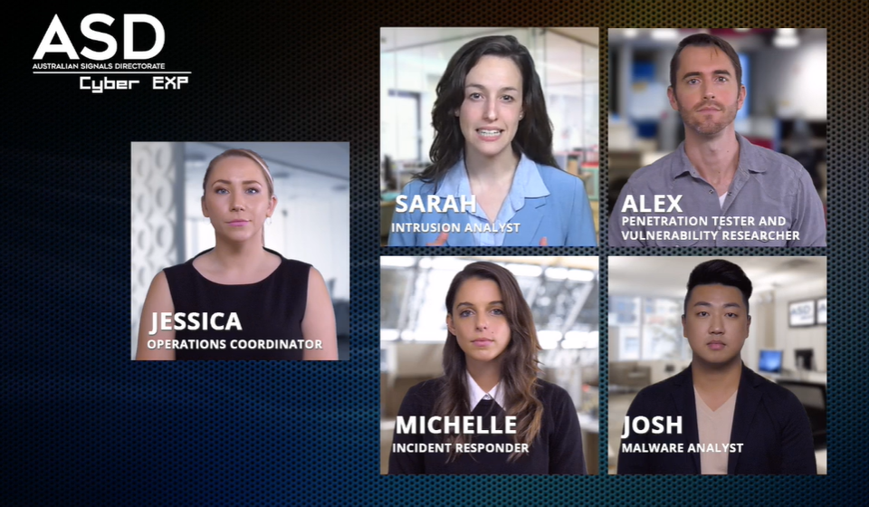
Preparation for Lab 1: Cyber Career Exploration Workshop
Jessica (Operations Coordinator) – Jessica ensures all security operations run smoothly by organizing resources, managing communication, and supporting the team.

Slide 30
Preparation for Lab 1: Cyber Career Exploration Workshop
Sarah (Intrusion Analyst) – Sarah detects and investigates cyber attacks by analyzing suspicious activities in networks and systems.

Slide 31
Preparation for Lab 1: Cyber Career Exploration Workshop
Alex (Penetration Tester and Vulnerability Researcher) – Alex finds weaknesses in computer systems by testing security defenses and helping organizations fix them before hackers can exploit them.

Slide 32
Preparation for Lab 1: Cyber Career Exploration Workshop
Michelle (Incident Responder) – Michelle reacts quickly to cyber attacks, identifies threats, and takes steps to stop damage and protect important data.

Slide 33
Preparation for Lab 1: Cyber Career Exploration Workshop
Josh (Malware Analyst) – Josh studies harmful software (malware) to understand how it works, how it spreads, and how to remove or prevent it.

Slide 34
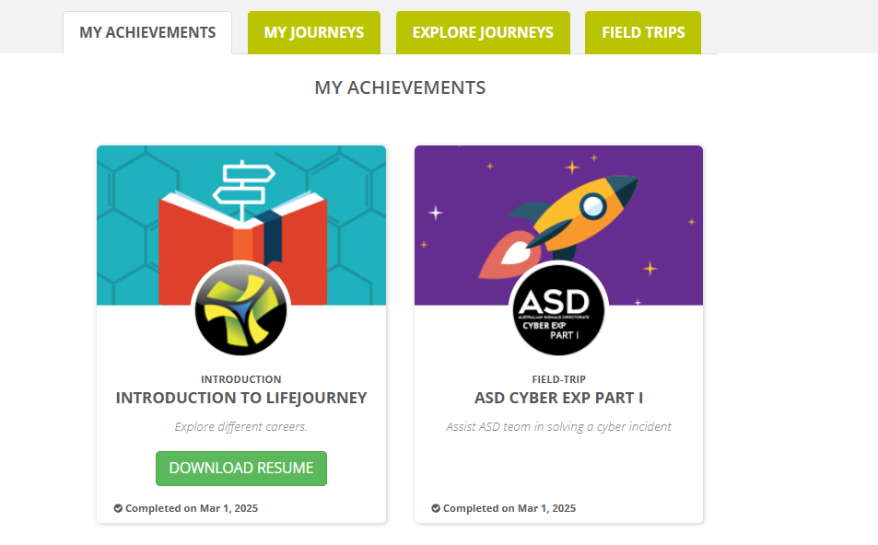
Preparation for Lab 1: Cyber Career Exploration Workshop
Step 5: Download the cyber resume and add a screenshot.

Slide 35
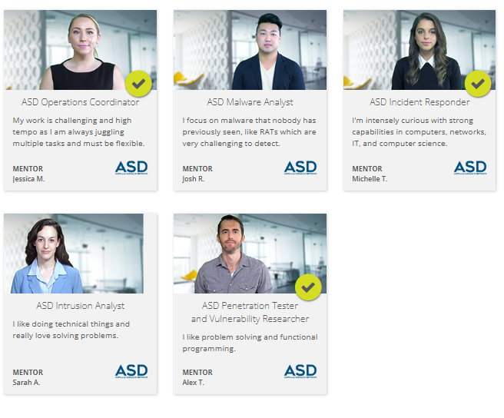
Preparation for Lab 1: Cyber Career Exploration Workshop
Step 6: Click on “Explore Journey” tab and explore the rest two careers at ASD.

Slide 36
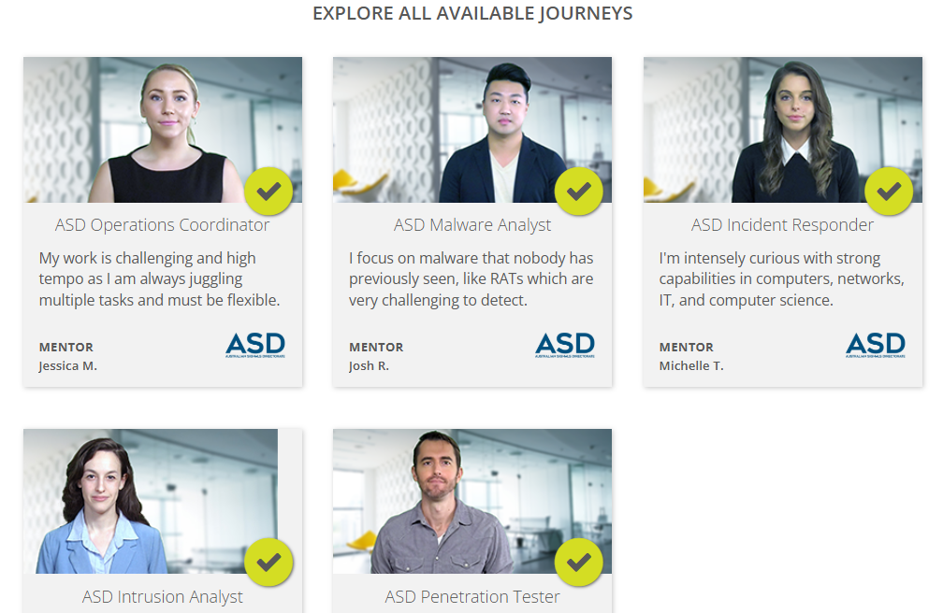
Preparation for Lab 1: Cyber Career Exploration Workshop

Slide 37
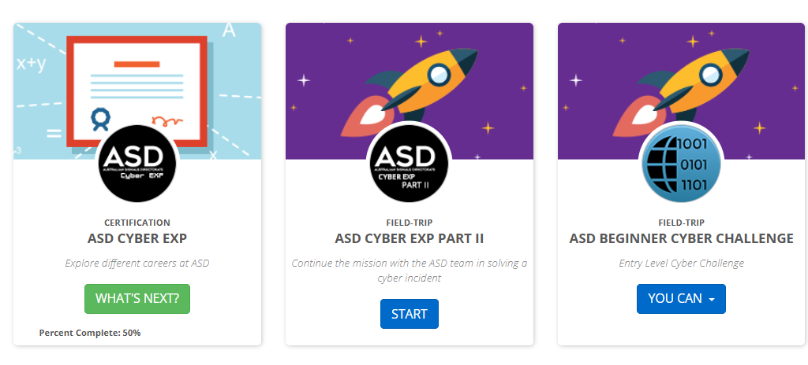
Preparation for Lab 1: Cyber Career Exploration Workshop
Step 7: Click on Field Trip. Complete the following: ASD CYBER EXP PART I and Part II, and ASD BEGINNER CYBER CHALLENGE

Slide 38
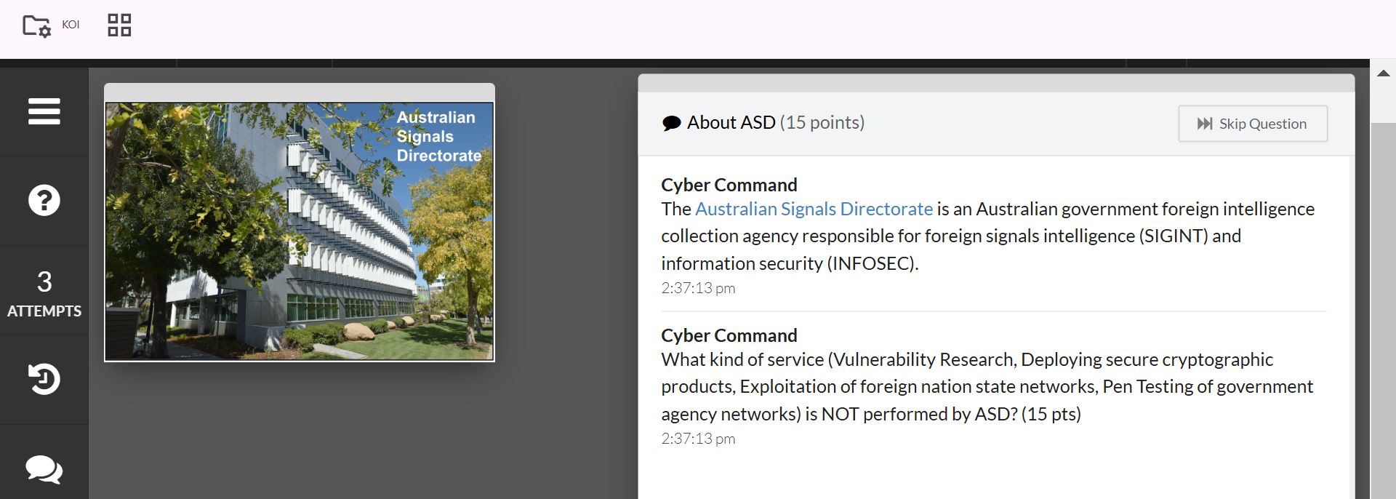
Preparation for Lab 1: Cyber Career Exploration Workshop
Exploitation of foreign nation-state networks" is NOT performed by ASD
Reason: ASD is an Australian government agency responsible for signals intelligence (SIGINT) and cybersecurity but does not engage in offensive hacking or direct exploitation of foreign government networks.

Slide 39
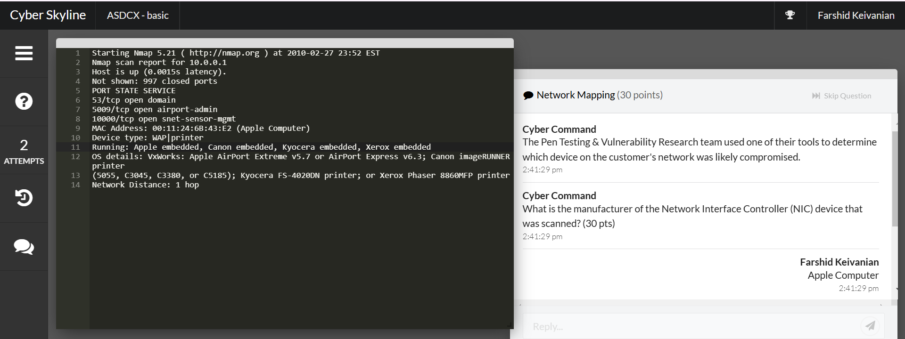
Preparation for Lab 1: Cyber Career Exploration Workshop
Apple Computer
Reasoning:
The MAC Address shown in the scan is 00:11:24:6B:43:E2. MAC addresses have unique prefixes assigned to manufacturers, and 00:11:24 is registered to Apple Inc.

Slide 40
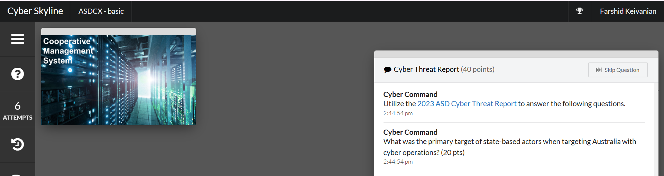
Preparation for Lab 1: Cyber Career Exploration Workshop
Critical infrastructure – data theft and disruption of business.
Reason:
According to the 2023 ASD Cyber Threat Report, state-sponsored cyber actors primarily targeted critical infrastructure in Australia.
The report highlights that government and critical infrastructure networks were targeted for espionage, data theft, and operational disruptions.

Slide 41
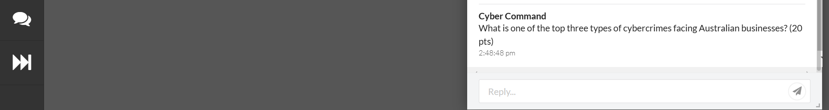
Preparation for Lab 1: Cyber Career Exploration Workshop
Business Email Compromise (BEC) fraud
Reason: According to the 2023 ASD Cyber Threat Report, one of the top three cybercrimes affecting Australian businesses is Business Email Compromise (BEC) fraud.
BEC attacks involve cybercriminals impersonating executives or trusted contacts to manipulate employees into transferring funds or sharing sensitive information.
These scams exploit human trust rather than technical vulnerabilities, making them highly effective and costly for businesses.
The report states that BEC fraud, online banking fraud, and email compromise are the leading cyber threats for businesses.

Slide 42
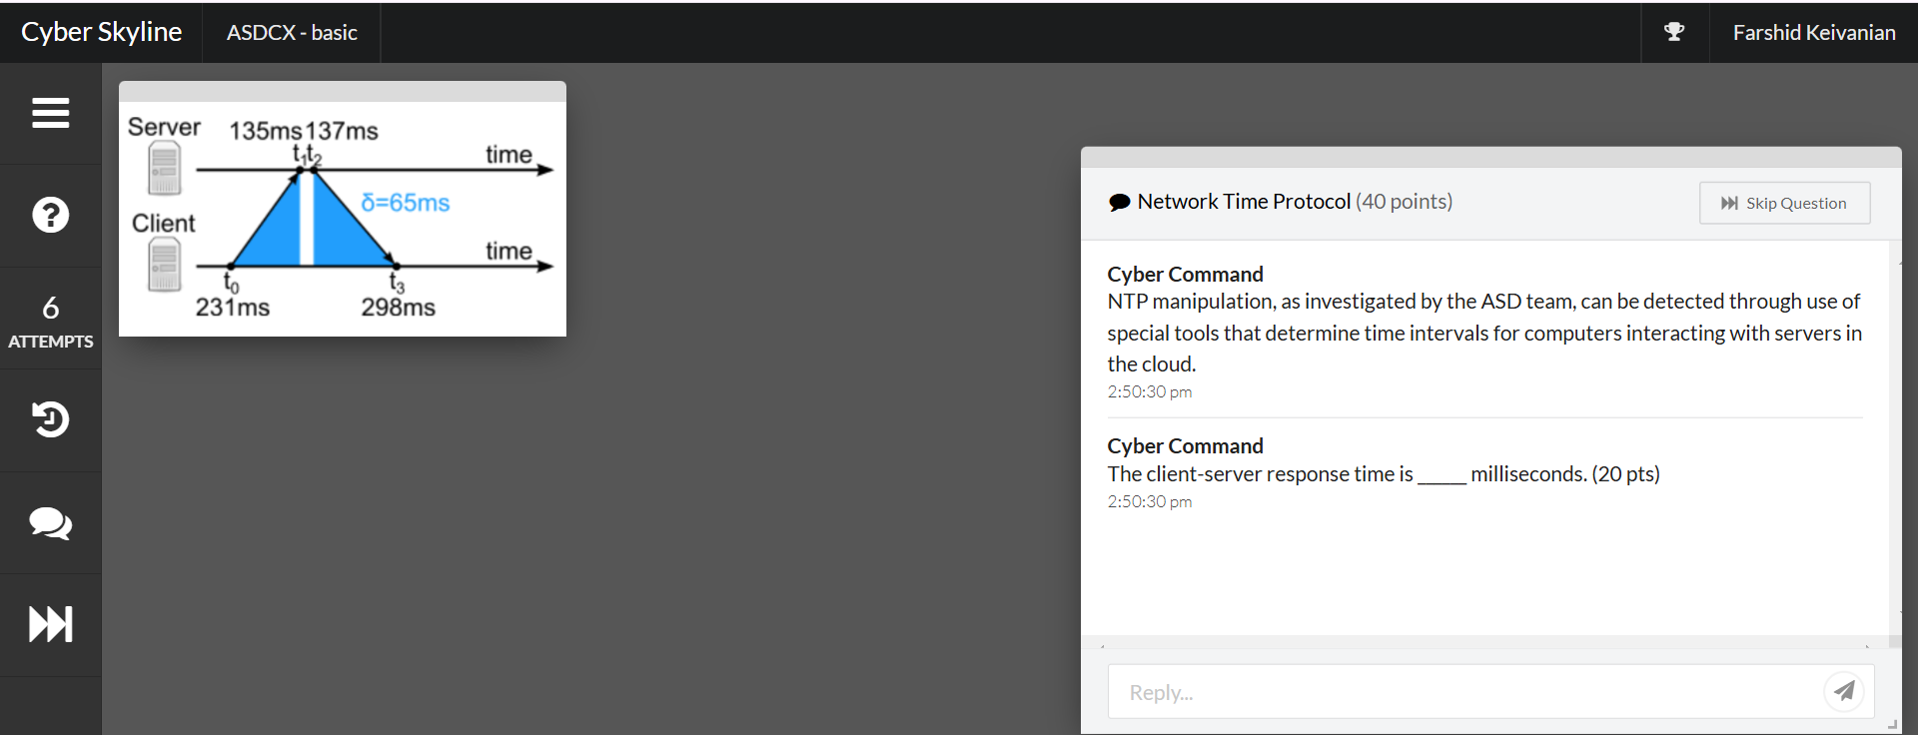
Preparation for Lab 1: Cyber Career Exploration Workshop
NTP manipulation would be evident in this client-server transaction if the time for "t0" was greater than ______ milliseconds. (20 pts)
298

Slide 43
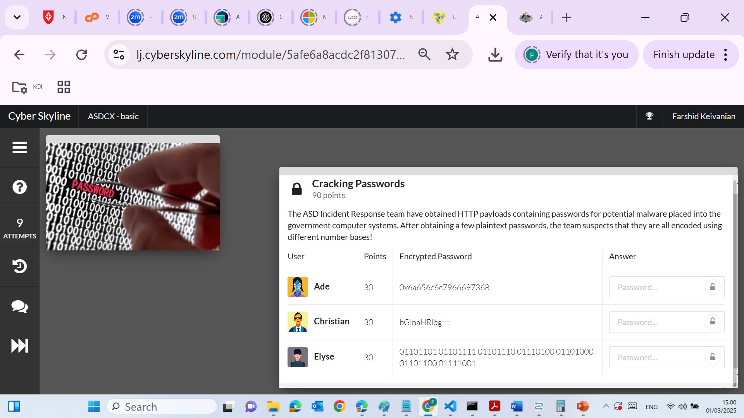
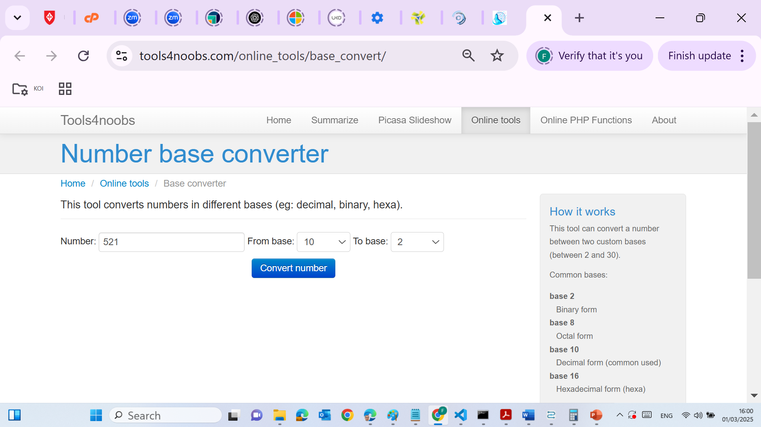
Preparation for Lab 1: Cyber Career Exploration Workshop
Hint #1
This challenge is based on recognizing different number bases. See https://www.tools4noobs.com/online_tools.... You can also can lookup RapidTables, Base64Decode, and Binary Hex Converter.
Jellyfish
Lighten
mothlock
0x indicates hexadecimal enconding
6a → j
65 → e
66 → f
6c → l
79 → y
66 → f
69 → i
73 → s
68 → h
Each 8-bit binary segment represents an ASCII character:
01101101 → m
01101111 → o
01110100 → t
01101000 → h
01101100 → l
01101111 → o
01100011 → c
01101011 → k

Slide 44
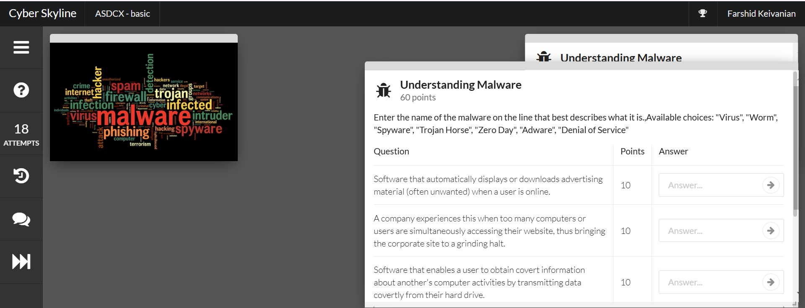
Preparation for Lab 1: Cyber Career Exploration Workshop

Slide 45
Preparation for Lab 1: Cyber Career Exploration Workshop
Question | Points | Correct Answer
Software that automatically displays or downloads advertising material (often unwanted) when a user is online. | 10 | Adware
A company experiences this when too many computers or users are simultaneously accessing their website, thus bringing the corporate site to a grinding halt. | 10 | Denial of Service
Software that enables a user to obtain covert information about another's computer activities by transmitting data covertly from their hard drive. | 10 | Spyware
A piece of code that is capable of copying itself and typically has a detrimental effect, such as corrupting the system or destroying data. | 10 | Virus
A standalone malware computer program that replicates itself in order to spread to other computers. | 10 | Worm
A program designed to breach the security of a computer system while ostensibly performing some innocuous function. | 10 | Trojan Horse

Slide 46
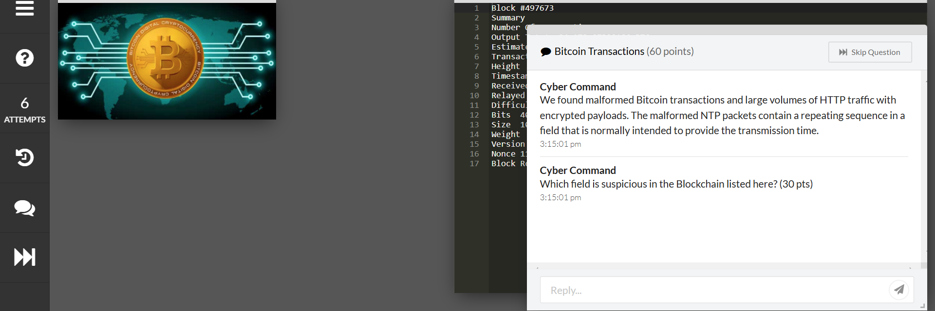
Preparation for Lab 1: Cyber Career Exploration Workshop
Timestamp Field
The Timestamp field in a Bitcoin block records the exact time when the block was mined. Normally, this value changes slightly and remains unique for each block.

Slide 47
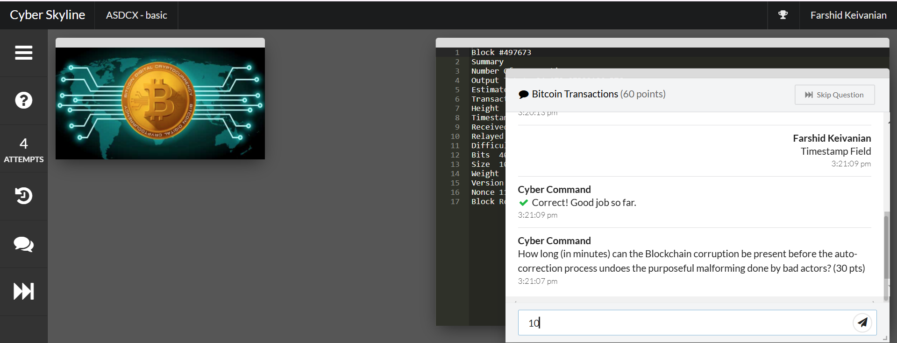
Preparation for Lab 1: Cyber Career Exploration Workshop
10 minutes - In Bitcoin's Blockchain, a new block is added approximately every 10 minutes through the mining process.
If an attacker malforms a transaction or block, it remains in the blockchain until the network detects and corrects it.
The longest possible time before the auto-correction process (via consensus and block validation) undoes the corruption is 10 minutes.
This happens because the next valid block will be created based on the longest valid chain, overriding any invalid transactions.

Slide 48
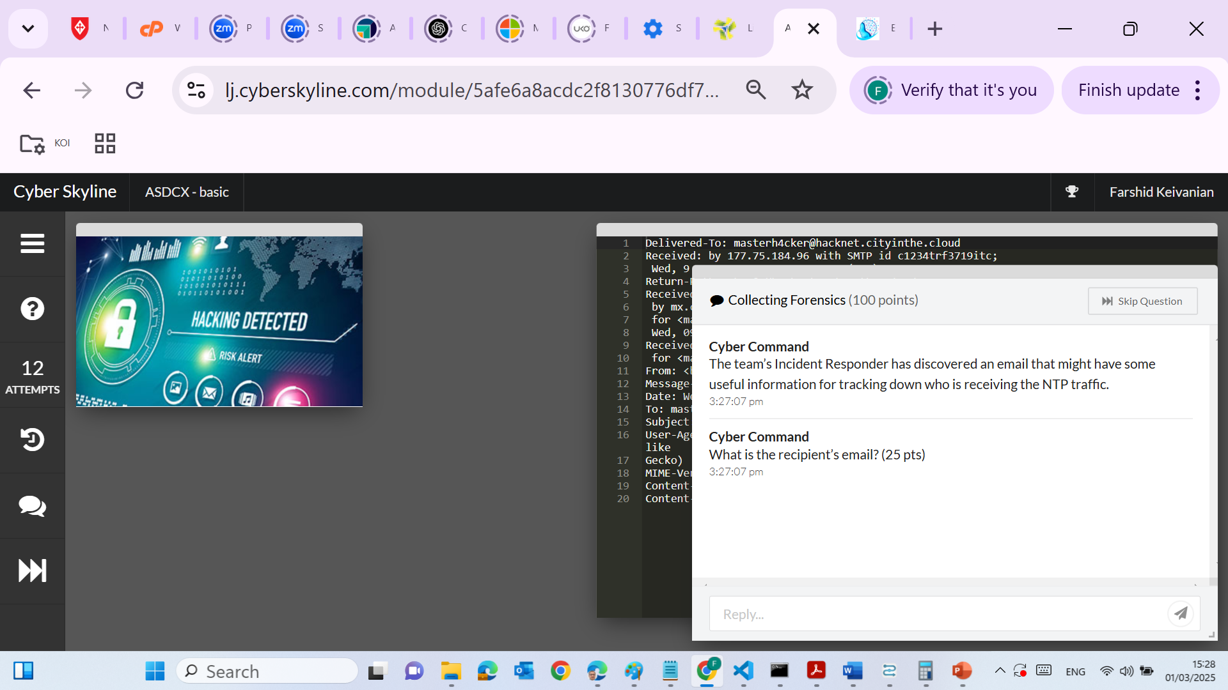
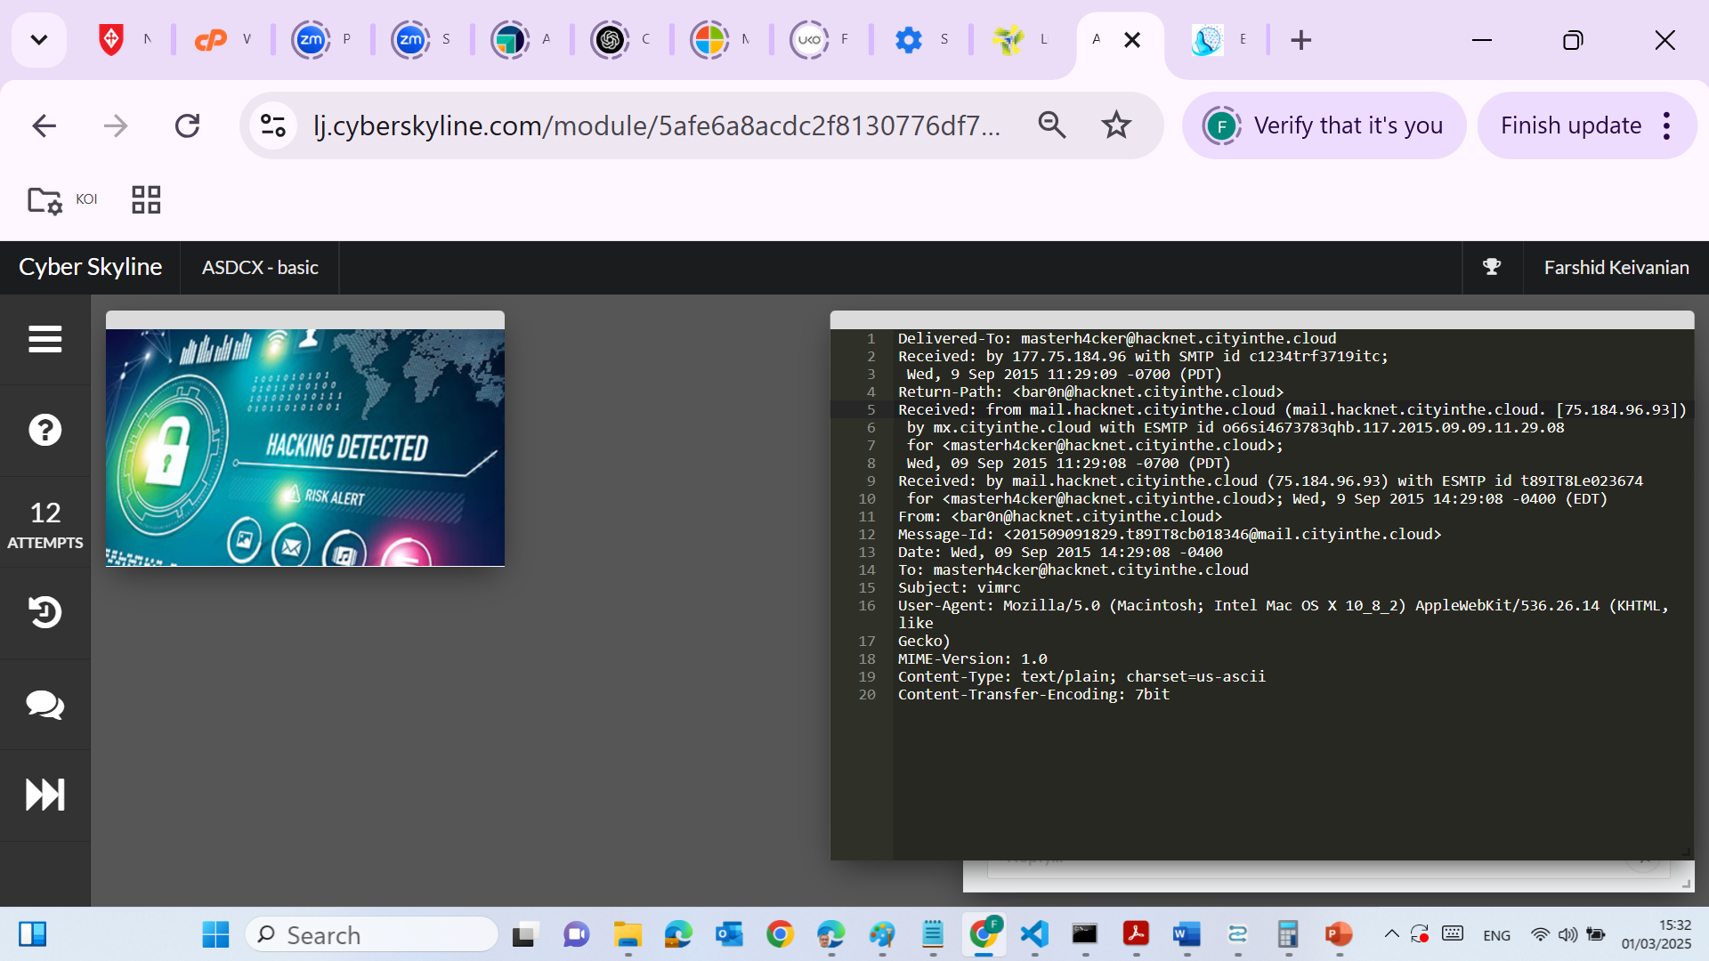
Preparation for Lab 1: Cyber Career Exploration Workshop
masterh4cker@hacknet.cityinthe.cloud
To find the recipient’s email address, we need to look at the email header.
Check the "To:" field – This field contains the email address of the intended recipient.
Found: To: masterh4cker@hacknet.cityinthe.cloud
Verify the "Delivered-To:" field – This confirms where the email was delivered.
Found: Delivered-To: masterh4cker@hacknet.cityinthe.cloud
This means masterh4cker@hacknet.cityinthe.cloud was the recipient of the email.
Ignore the "From:" field – This is the sender’s email address, which is not the requested answer.
Sender: bar0n@hacknet.cityinthe.cloud

Slide 49

Preparation for Lab 1: Cyber Career Exploration Workshop
bar0n@hacknet.cityinthe.cloud
To find the sender’s email address, we need to look at the "From:" and "Return-Path:" fields in the email header.
Check the "From:" field – This field shows who sent the email.
Found: From: <bar0n@hacknet.cityinthe.cloud>
Verify with the "Return-Path:" field – This is used for bounce-back messages and often confirms the sender.
Found: Return-Path: <bar0n@hacknet.cityinthe.cloud>
This matches the "From:" field, confirming that bar0n@hacknet.cityinthe.cloud is the correct sender.

Slide 50
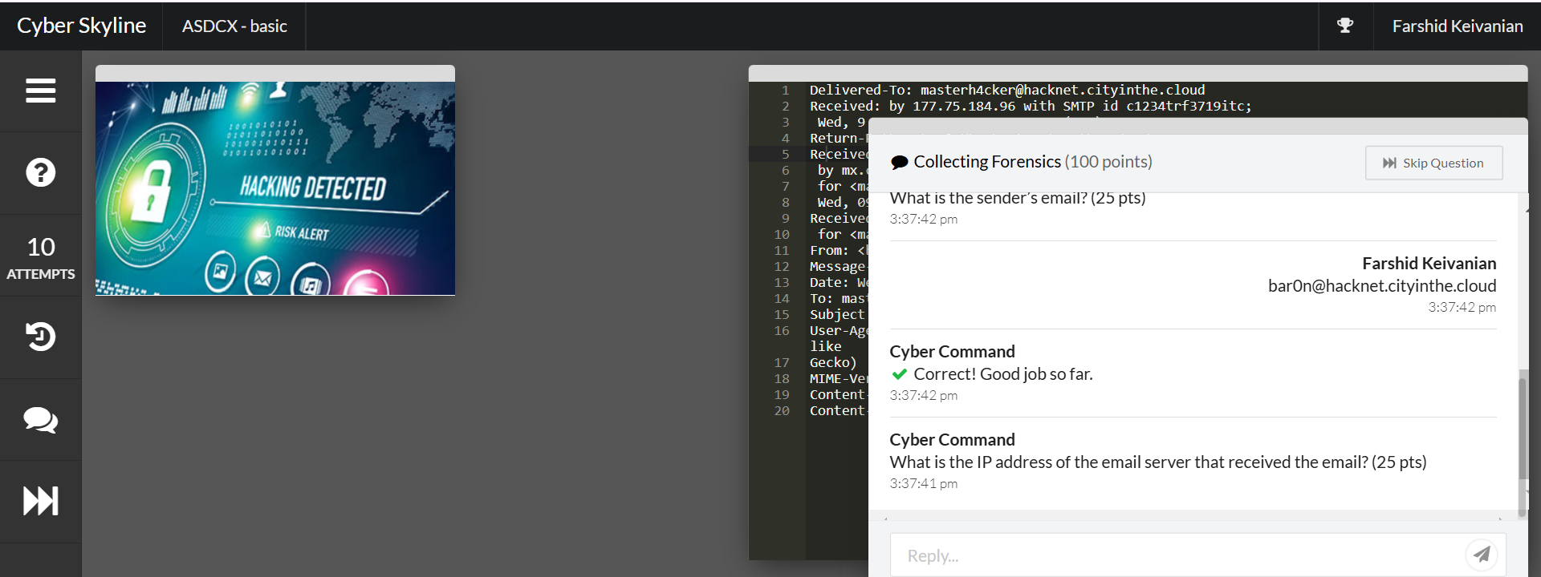
Preparation for Lab 1: Cyber Career Exploration Workshop
177.75.184.96
The first recorded "Received:" line is:
Received: by 177.75.184.96 with SMTP id c1234trf3719itc;
Emails travel through multiple servers, and each "Received" line documents a step in the journey.

Slide 51
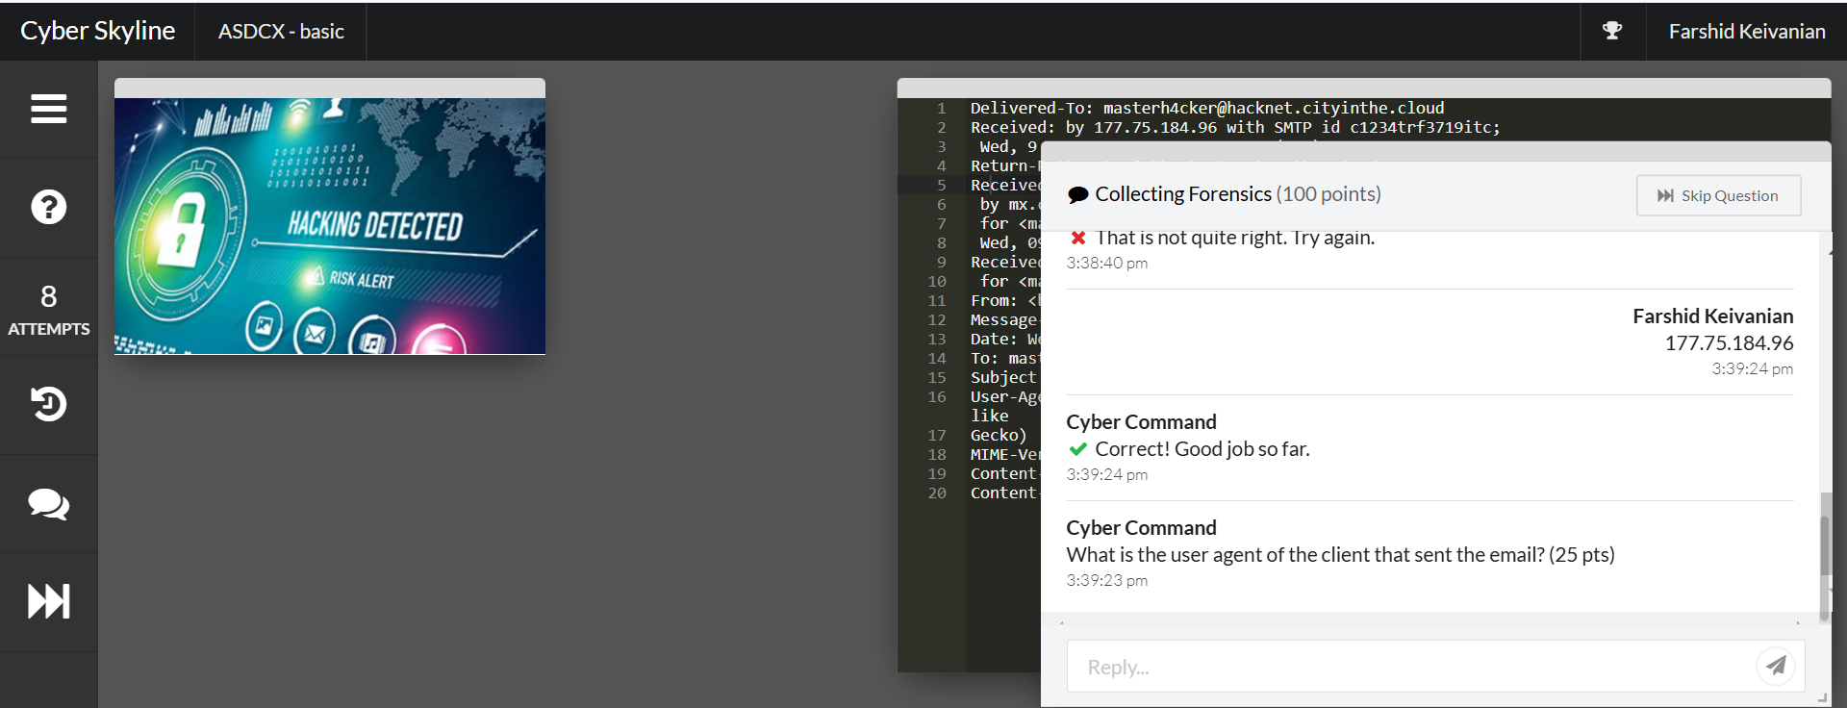
Preparation for Lab 1: Cyber Career Exploration Workshop
Mozilla/5.0 (Macintosh; Intel Mac OS X 10_8_2) AppleWebKit/536.26.14 (KHTML, like Gecko)
To determine the User-Agent of the client that sent the email, we need to look at the User-Agent header in the email metadata.
Find the "User-Agent" field in the email headers:
This field tells us what software the sender used to compose and send the email.

Slide 52
Preparation for Lab 1: Cyber Career Exploration Workshop
Mozilla/5.0 (Macintosh; Intel Mac OS X 10_8_2) AppleWebKit/536.26.14 (KHTML, like Gecko)
User-Agent: Mozilla/5.0 (Macintosh; Intel Mac OS X 10_8_2) AppleWebKit/536.26.14 (KHTML, like Gecko)
Mozilla/5.0 → The base user-agent string (indicating a browser-like client).
Macintosh; Intel Mac OS X 10_8_2 → The sender's operating system (Mac OS X 10.8.2).
AppleWebKit/536.26.14 (KHTML, like Gecko) → The web engine used (WebKit-based, similar to Safari/Chrome).

Slide 53
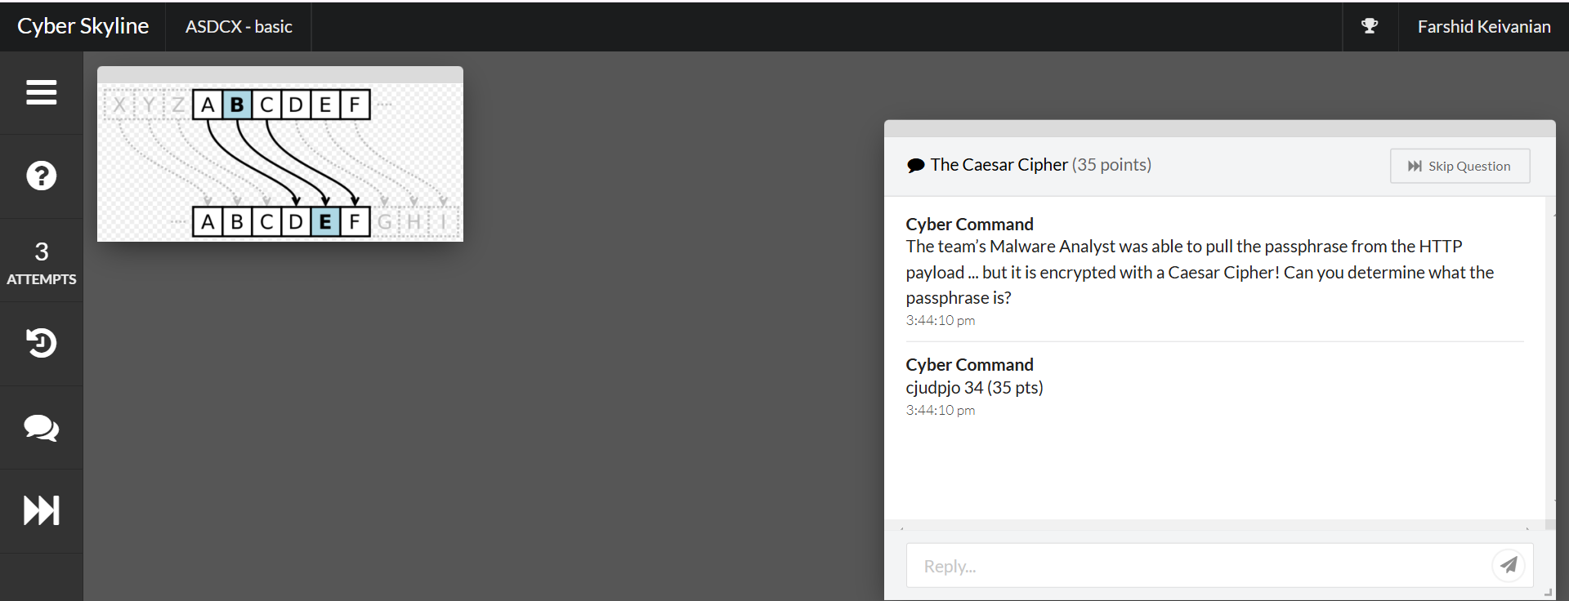
Preparation for Lab 1: Cyber Career Exploration Workshop
The given text "cjudpjo 34" is encrypted using a Caesar Cipher, which shifts letters forward or backward in the alphabet by a fixed number of places.

Slide 54
Preparation for Lab 1: Cyber Career Exploration Workshop
How to Decrypt It
The Caesar Cipher shifts letters forward or backward by a certain number.
We need to determine the shift value and apply it in reverse to find the original text.
A common shift value is 3 (as used in classical Caesar Cipher), so we will first try shifting backward by 3 places.

Slide 55
Preparation for Lab 1: Cyber Career Exploration Workshop
Let's decrypt "cjudpjo" by shifting each letter backward by 3 places:
c → z
j → g
u → r
d → a
p → m
j → g
o → l

Slide 56
Preparation for Lab 1: Cyber Career Exploration Workshop
Thus, "cjudpjo" decrypts to: "zgramgl"
The number "34" remains the same as numbers are not affected by a shift cipher.
Final Answer:
zgramgl 34

Slide 57
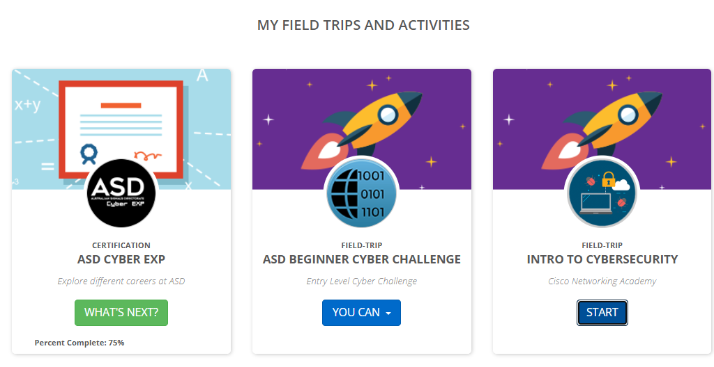
Preparation for Lab 1: Cyber Career Exploration Workshop

Slide 58
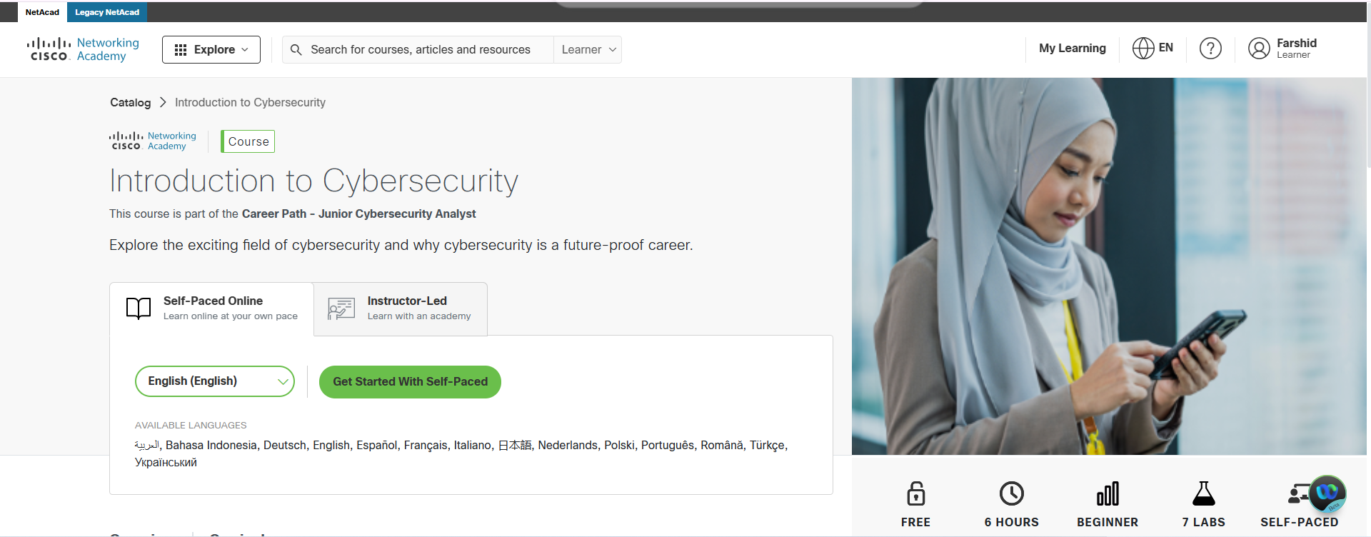
Preparation for Lab 1: Cyber Career Exploration Workshop

Slide 59
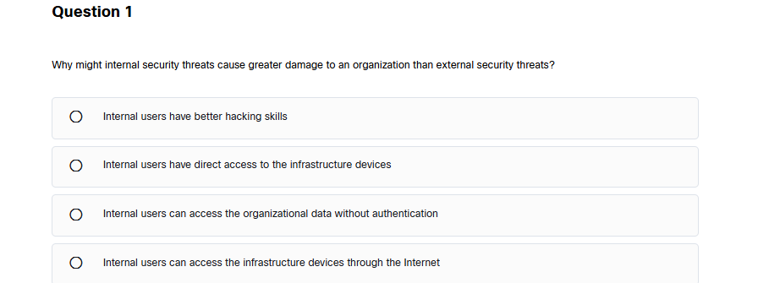
Preparation for Lab 1: Cyber Career Exploration Workshop
Internal users have direct access to the infrastructure devices.
Explanation:
Internal security threats are more dangerous because employees and insiders already have authorized access to systems, databases, and infrastructure. Unlike external hackers, they do not need to bypass security defenses such as firewalls or authentication barriers. A malicious insider or a negligent employee can cause significant damage by misusing their privileges, accessing sensitive data, or disrupting services.

Slide 60
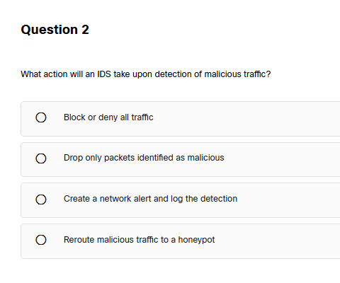
Preparation for Lab 1: Cyber Career Exploration Workshop
Create a network alert and log the detection.
An Intrusion Detection System (IDS) is a security tool that monitors network traffic and looks for suspicious activities or attacks. However, an IDS does not take direct action to stop the threat; instead, it:
Detects malicious traffic.
Creates an alert to notify security teams.
Logs the event for further analysis.
Unlike a firewall or an Intrusion Prevention System (IPS), an IDS does not block or filter traffic automatically. Instead, it acts like a security camera, watching for threats and informing administrators, who then decide on the necessary actions.

Slide 61
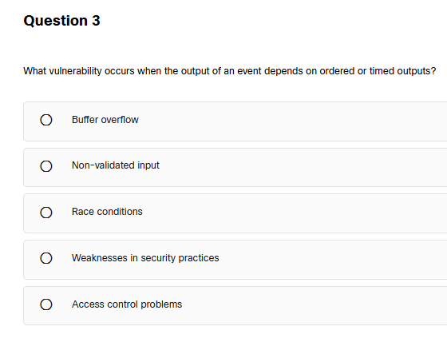
Preparation for Lab 1: Cyber Career Exploration Workshop
Race conditions"
A race condition is a type of software vulnerability that happens when a system's behavior depends on the timing or order of events. If two or more processes try to access and modify shared data at the same time, the outcome can be unpredictable and may lead to security issues.
Example in Simple Terms:
Imagine two people trying to withdraw money from the same bank account at the exact same time. If the system does not properly manage the transactions, both could withdraw money before the system updates the balance, leading to more money being taken out than actually exists in the account.
How Attackers Exploit Race Conditions:
Privilege Escalation: Attackers can gain higher-level access by taking advantage of timing issues in authentication processes.
Bypassing Security Checks: If an action is allowed before verification is completed, hackers can execute unauthorized operations.
Data Corruption: If two operations modify the same data at the same time, the data might become incorrect or unreadable.

Slide 62
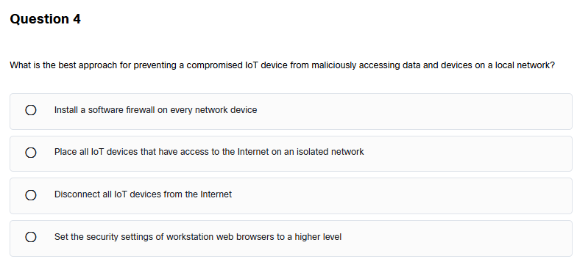
Preparation for Lab 1: Cyber Career Exploration Workshop
Place all IoT devices that have access to the Internet on an isolated network.
The Internet of Things (IoT) includes smart devices like security cameras, thermostats, and smart speakers that connect to the Internet. These devices are more vulnerable to cyberattacks because:
Many lack strong security features.
They often don’t receive frequent updates.
Attackers can use them to spread malware or access other devices.
Solution: Network Isolation To protect the main network, we should:
Place IoT devices on a separate network (also called a VLAN or isolated subnet).
Limit their access so they cannot communicate with sensitive devices.
Use strong passwords and update firmware regularly.
By doing this, even if an IoT device is hacked, the attacker cannot reach important computers, databases, or company systems.

Slide 63
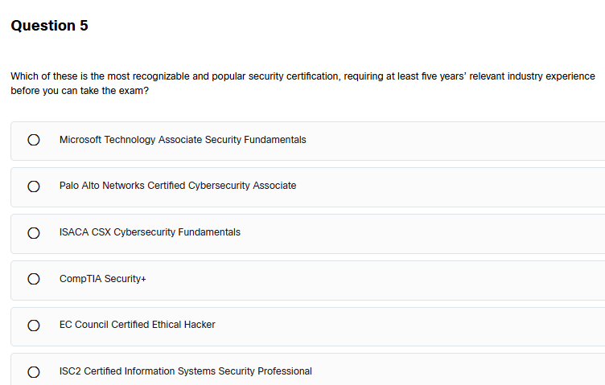
Preparation for Lab 1: Cyber Career Exploration Workshop
ISC2 Certified Information Systems Security Professional (CISSP)
The Certified Information Systems Security Professional (CISSP) is one of the most well-known and respected cybersecurity certifications. It is designed for experienced security professionals who want to prove their skills in areas such as:
Security and risk management
Asset security
Cryptography
Network security

Slide 64
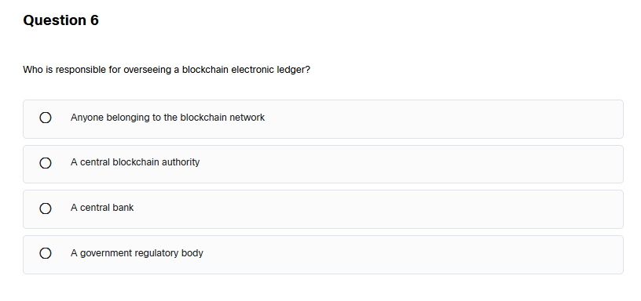
Preparation for Lab 1: Cyber Career Exploration Workshop
Anyone belonging to the blockchain network."
Blockchain is a decentralized system, meaning no single authority (like a government or central bank) controls it. Instead, all participants (also called nodes) in the blockchain network share responsibility for maintaining and verifying the ledger.
Key Points:
Decentralization: No central authority manages blockchain; instead, participants validate transactions.
Consensus Mechanism: Transactions are verified through consensus methods like Proof of Work (PoW) or Proof of Stake (PoS).
Security & Transparency: Data is stored across multiple computers, making it tamper-resistant and transparent.
Example:
Bitcoin and Ethereum operate without a central bank. Instead, miners (in PoW) or validators (in PoS) ensure that transactions are legitimate.

Slide 65
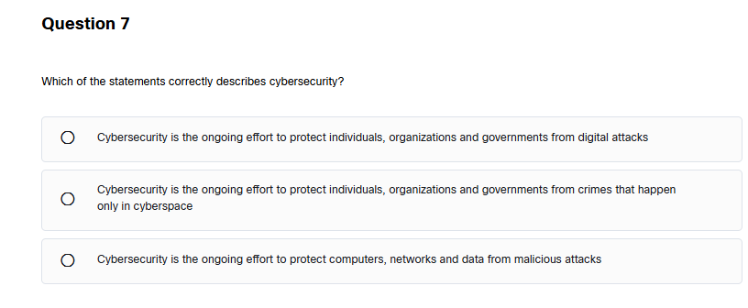
Preparation for Lab 1: Cyber Career Exploration Workshop
Cybersecurity is the ongoing effort to protect computers, networks, and data from malicious attacks."
Explanation for Lecture (Simple and Clear)
Cybersecurity is all about protecting digital systems, networks, and sensitive data from threats such as:
Hackers trying to steal information.
Viruses and malware that damage systems.
Phishing attacks tricking people into giving away passwords.
Why is this answer correct?
Cybersecurity is not limited to just individuals, companies, or governments—it applies to everyone.
Cyber threats do not only exist in cyberspace—they can also involve physical security risks like stolen hardware or insider threats.
The goal of cybersecurity is to prevent, detect, and respond to threats before they cause damage.

Slide 66
Preparation for Lab 1: Cyber Career Exploration Workshop
Example for Understanding:
Imagine your bank account details being leaked because of a weak password or a hacked system. Cybersecurity measures, such as strong passwords, two-factor authentication (2FA), and encryption, help prevent such attacks.

Slide 67
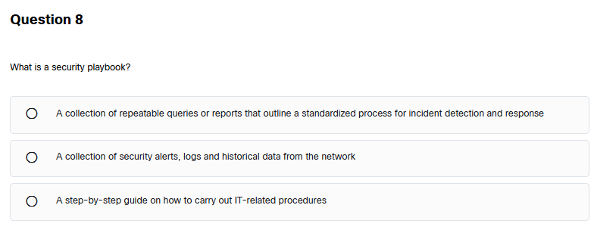
Preparation for Lab 1: Cyber Career Exploration Workshop
A collection of repeatable queries or reports that outline a standardized process for incident detection and response.

Slide 68

Preparation for Lab 1: Cyber Career Exploration Workshop
Weaknesses in security practices.
Reason:
Creating custom security algorithms is risky because:
Lack of rigorous testing: Well-known encryption algorithms like AES and RSA undergo years of expert testing.
Higher chances of flaws: Custom algorithms may contain bugs or logic errors that hackers can easily exploit.
Lack of peer review: Established algorithms are reviewed by global security experts, making them more reliable.

Slide 69

Preparation for Lab 1: Cyber Career Exploration Workshop
✔ Is self-replicating"
✔ "Travels to new computers without any intervention or knowledge of the user"
A worm is a type of malware that:
Spreads automatically without user action.
Self-replicates by making copies of itself across networks.
Does not need to attach to software or files (unlike viruses).
How Worms Spread:
Through network vulnerabilities (e.g., outdated systems).
Via email attachments with malicious links.
Using removable drives like USBs.
Example:
The WannaCry ransomware worm (2017) spread worldwide by exploiting a Windows vulnerability, affecting hospitals, businesses, and governments.

Slide 70

Preparation for Lab 1: Cyber Career Exploration Workshop
Physically destroying your computer’s hard drive

Slide 71

Preparation for Lab 1: Cyber Career Exploration Workshop
"To cause physical damage to equipment controlled by computers."
Stuxnet was a highly sophisticated cyberweapon designed to target industrial control systems (ICS), specifically Iran’s nuclear centrifuges.
How Stuxnet Worked:
It infected Windows computers through USB drives and spread across networks.
It targeted Siemens PLCs (Programmable Logic Controllers) used in nuclear enrichment facilities.
It altered the centrifuge speeds, causing them to malfunction and physically break down over time.
Why Stuxnet Was Unique:
It was one of the first known cyberattacks that caused real-world physical damage.
It was not designed to steal data or take control of computers, but to destroy industrial equipment.
Impact:
It delayed Iran’s nuclear program by damaging thousands of centrifuges.
It set a precedent for cyber warfare and industrial sabotage.

Slide 72
Preparation for Lab 1: Cyber Career Exploration Workshop
"To cause physical damage to equipment controlled by computers."
Stuxnet was a highly sophisticated cyberweapon designed to target industrial control systems (ICS), specifically Iran’s nuclear centrifuges.
How Stuxnet Worked:
It infected Windows computers through USB drives and spread across networks.
It targeted Siemens PLCs (Programmable Logic Controllers) used in nuclear enrichment facilities.
It altered the centrifuge speeds, causing them to malfunction and physically break down over time.
Why Stuxnet Was Unique:
It was one of the first known cyberattacks that caused real-world physical damage.
It was not designed to steal data or take control of computers, but to destroy industrial equipment.
Impact:
It delayed Iran’s nuclear program by damaging thousands of centrifuges.
It set a precedent for cyber warfare and industrial sabotage.

Slide 73

Preparation for Lab 1: Cyber Career Exploration Workshop
"To cause physical damage to equipment controlled by computers."
Stuxnet was a highly sophisticated cyberweapon designed to target industrial control systems (ICS), specifically Iran’s nuclear centrifuges.
How Stuxnet Worked:
It infected Windows computers through USB drives and spread across networks.
It targeted Siemens PLCs (Programmable Logic Controllers) used in nuclear enrichment facilities.
It altered the centrifuge speeds, causing them to malfunction and physically break down over time.
Why Stuxnet Was Unique:
It was one of the first known cyberattacks that caused real-world physical damage.
It was not designed to steal data or take control of computers, but to destroy industrial equipment.
Impact:
It delayed Iran’s nuclear program by damaging thousands of centrifuges.
It set a precedent for cyber warfare and industrial sabotage.

Slide 74
Preparation for Lab 1: Cyber Career Exploration Workshop
Step 8: After completion, paste a screenshot of your achievements page. Also paste a screenshot of leader board score (click on view leader board button).

Slide 75

Preparation for Lab 1: Cyber Career Exploration Workshop

Slide 76
Preparation for Lab 1: Cyber Career Exploration Workshop
Part B: Answer the following Questions.
What are the security goals?
C: Confidentiality; I: Integrity; A: Availability

Slide 77
Preparation for Lab 1: Cyber Career Exploration Workshop
Part B: Answer the following Questions.
What are the common security threats?
Intrusion, Malware (virus, worm, trozan horse), Phishing, Spyware, Spam

Slide 78
Preparation for Lab 1: Cyber Career Exploration Workshop
Part B: Answer the following Questions.
Define some security measures to protect your computer
Safely mange your password.
Safely manage your email account
Secure your computer
Protect the data you are handling
Avoid risky behavior online.
Be aware of security guidelines, policies, and procedures

Slide 79
Preparation for Lab 1: Cyber Career Exploration Workshop
Part B: Answer the following Questions.
What is Identity theft? How it happens?
Identity Theft is a crime in which an impostor obtains key pieces of Personal Identifying Information (PII) such as Social Security Numbers and driver’s license numbers and uses them for their own personal gain.
Stolen wallet
Pilfered mail
Computer virus
Phishing and Social Engineering
Social Networking account
License plate
Health records
Financial Data

Slide 80
Preparation for Lab 1: Cyber Career Exploration Workshop
Part B: Answer the following Questions.
How can you defend against identity theft attacks?
secure your mail box with a lock and make sure mail is cleared regularly
shred or destroy your personal and financial papers before you throw them away, or keep them in a secure place if you wish to retain them
always cover the keypad at ATMs or on EFTPOS terminals when entering your PIN, and be aware of your surroundings— is anyone trying to observe or watch you, are there any strange or loose fixtures attached to the machine or terminal?
ensure that the virus and security software on your computers and mobile devices is up-to-date and current

Slide 81
Thank You
Have a Great Learning Day!
Feel free to reach out with any questions!

